Slide 1
Notes:
Main Page

Slide 2
Presentation Title Here
USING ACUITY STAR FOR PROMOTIONS
Author: Derrick Gould
Date: April 2, 2015
Audience: Clinical Faculty
For More Information please contact:
Derrick Gould
St Joseph’s Health Care London
268 Grosvenor St E4-118
London, Ontario
x32115
Notes:
Title Page

Slide 3
About STAR
STAR is an online secure Web Application which allows authorized users to track, report and manage their academic reportable activities. (Curriculum Vitae)
STAR easily allows Clinical Faculty members or their secretaries to login to STAR, and find, add, edit or delete database entries quickly, and regenerate a new updated document.
STAR allows you to easily generate a Full Professional CV, promotion CV or teaching dossier very quickly, in a standard format.
The defining principle of the STAR project is...
Record all activities only once and allow us to report the activities many times from that one place.
We are now exploring opportunities to electronically connect the STAR database to other external databases to allow the secure flow of information from STAR to other databases to ensure that information is coming from authoritative source. (Common CV, Mainport, Mainpro, Etc)
STAR will produce department level aggregated reports like Research Reports, Publication Lists, Grant Reports and others.
Simply put, the more ways we can use (and re-use) the recorded activity data, the less time (and work) members or their secretaries will have to do, which will lead to higher value for our members from our investment in STAR.
Notes:
Title Page

Slide 4
Your STAR Contacts
Faculty Administrator: Derrick Gould STAR Trainer: Paul Malcomson
https://www.schulich.uwo.ca/star/contacts
Medicine |  | Obstetrics & Gynecology |  | Surgery
Chair/Chief: Dr. Jim Calvin Admin Officer: Sue Thomsen STAR Coordinator: Cathy Cole |  | Chair/Chief: Dr. Margaretha Rebel Admin Officer: Lisa Johnson STAR Coordinator: Jennifer Cordick |  | Chair/Chief: Dr. Emil Schemitsch Admin Officer: Dinah Frank STAR Coordinator: Melissa Serrano
Medical Imaging |  | Psychiatry |  | Pathology
Chair/Chief: Dr. Andrea Lum Admin Officer: Nancy Kalbfleisch STAR Coordinator: Kellie Griffin |  | Chair/Chief: Dr. Paul Links Admin Officer: Roland Kriening STAR Coordinator: Stephanie Commisso |  | Chair/Chief: Dr. Subrata Chakrabarti Admin Officer: Mair Hughes STAR Coordinator: Mellonie Carnahan
Clinical Neurological Sciences |  | Physical Medicine & Rehabilitation |  | Family Medicine
Chair/Chief: Dr. Paul Cooper Admin Officer: Nicole Farrell STAR Coordinator: Karen Baptista |  | Chair/Chief: Dr. Timothy Doherty Admin Officer: Laura Gabriel STAR Coordinator: Debra Benton |  | Chair/Chief: Dr. Stephen Wetmore Admin Officer: Joanne Gibb STAR Coordinator: Linda Gough
Otolaryngology |  | Anesthesia & Perioperative Medicine |  | Ophthalmology
Chair/Chief: Dr. John Yoo Admin Officer: Ann Jones STAR Coordinator: Charlotte Towle |  | Chair/Chief: Dr. Davy C.H. Cheng Admin Officer: Lois Hayter STAR Coordinator: Brie McConnell |  | Chair/Chief: Dr. David Nicolle Admin Officer: Laura Gabriel STAR Coordinator: Patrick VanHie
Paediatrics |  |  |  | Oncology
Chair/Chief: Dr. Guido Filler Admin Officer: Patty Smith STAR Coordinator: Jill O'Dowda |  |  |  | Chair/Chief: Dr. Glen Bauman Admin Officer: Kim Norton STAR Coordinator: Stephanie Commisso
Notes:
Title Page

Slide 5
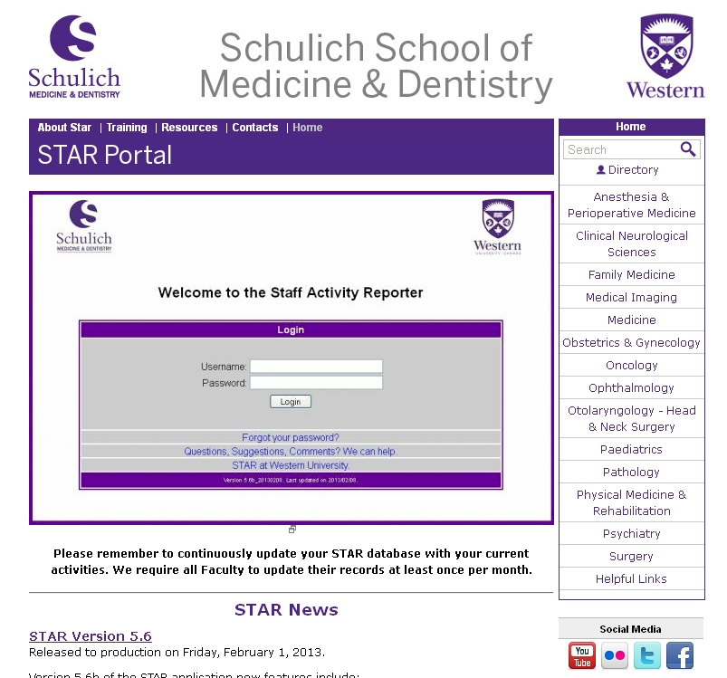
Login Information
STAR Portal:
https://www.schulich.uwo.ca/star/
STAR Program:
https://star.schulich.uwo.ca/
* To obtain your login credentials, please contact your STAR Coordinator.
Notes:
Title Page

Slide 6
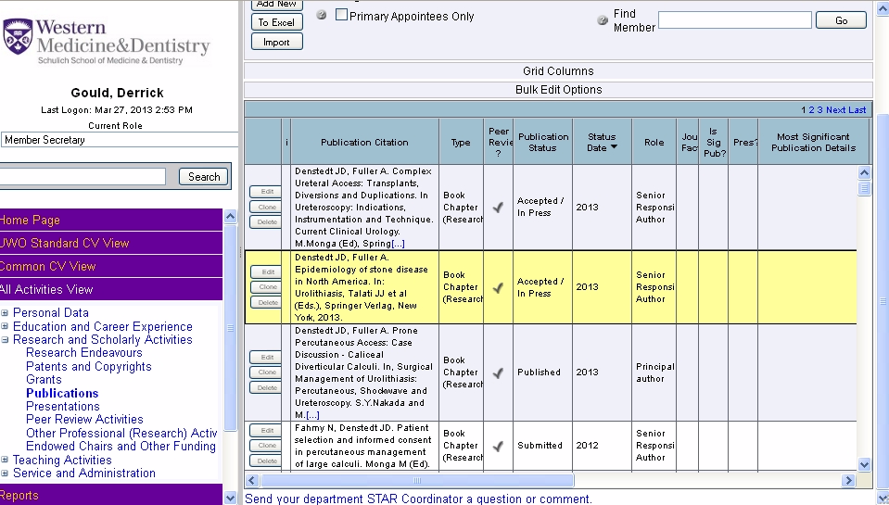
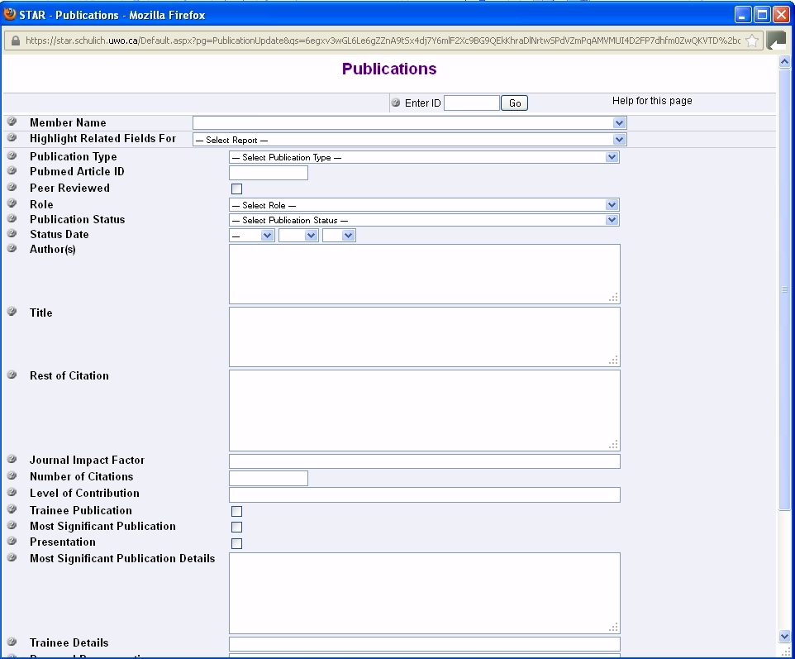
Using STAR
STAR – Data Grid
STAR – Data Form
* We suggest using Firefox as the browser of choice for using STAR
Notes:
Title Page

Slide 7
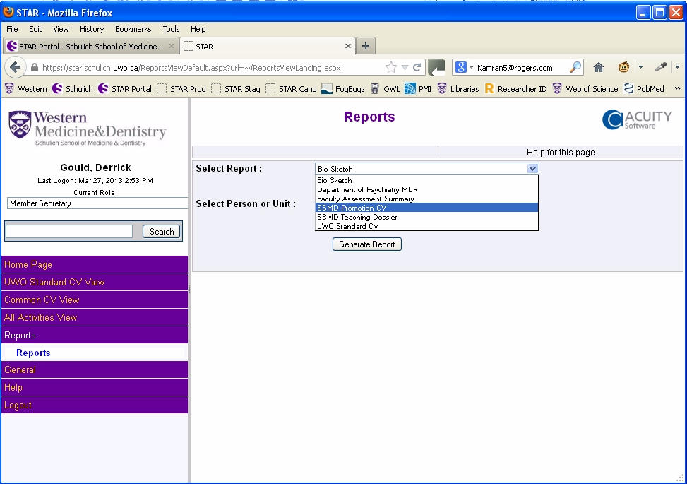
Promotion Reports
Generating STAR Reports
Promotion CV
Teaching Dossier
* Reports are generated in .rtf format which is a MS-Word readable document.
Notes:
Title Page

Slide 8
Training
Courses are available monthly at each of the London Hospitals
Other courses may be set up as needed.
Notes:
Title Page

Slide 9
Resources
Notes:
Title Page

Slide 10
Brief Demonstration
STAR Program:
https://star.schulich.uwo.ca/
Notes:
Title Page

Slide 11
Help Using STAR
First Level Support Tools: Documentation and Help
- In Program Help Icons
- Reference Guide
- Example Documents
- YouTube Training Videos
- Tips and Tricks Document
Second Level Support: STAR Coordinator
- Your Department has a STAR Coordinator.
- https://www.schulich.uwo.ca/star/contacts
- If first level support does not answer your question, call them first!
Third Level Support: Project Management
- Paul Malcomson, Derrick Gould
- Call us if your STAR coordinator cannot help you
Fourth Level Support: Acuity Development & Troubleshooting
- I call them no cost
- If you call them they will send you a bill.
Notes:
Title Page

Slide 12
Next Steps
Get this presentation and bookmark the STAR Portal
Bookmark the STAR program
Contact your STAR Coordinator and get your STAR Login Credentials
Register for a training class
Login to STAR and review your data
Generate your Promotion Documents and Review
Notes:
Title Page

Slide 13
Questions?
Notes:
Title Page

Slide 14
Notes:
Main Page

